Slide 1
What is node?
Node and Apache as server web:
Apache : Its create one Treads for one resquest.
Node : Its create one Treads but these is concurrent.

Slide 2
More Node
Node implemnts protocolos as HTTP, DNS, TLS, SSL, otros
Node para Manejo de aplicaciones de alto tráfico

Slide 3
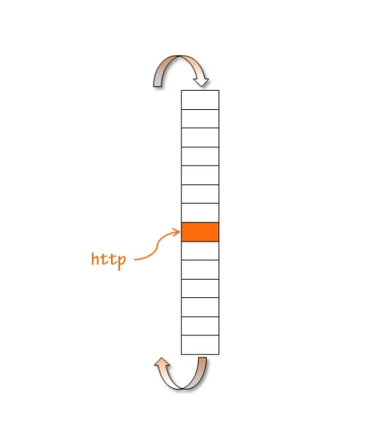
Node's Event Loop

Slide 4
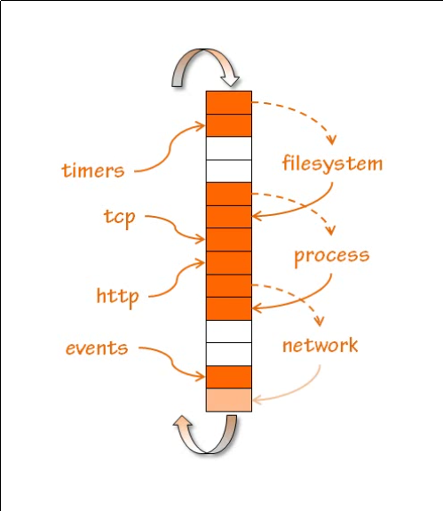
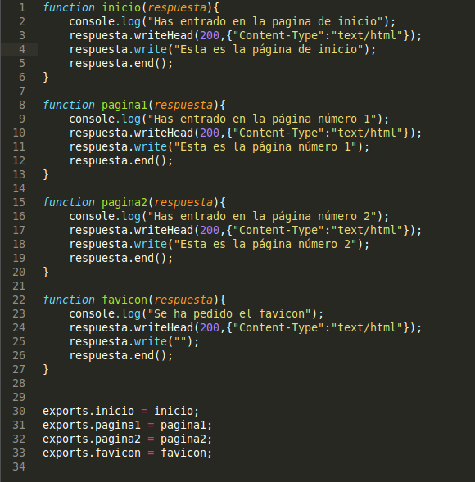
Node's Event Loop

Slide 5
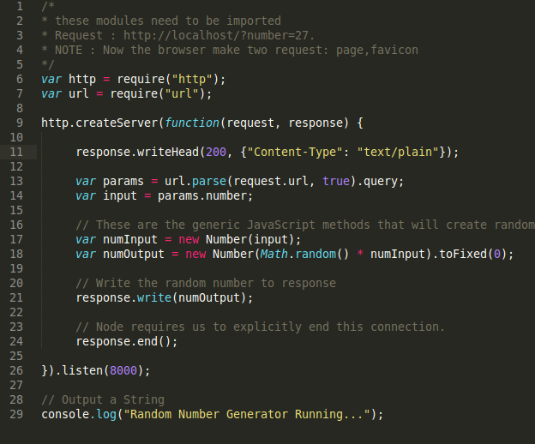
Server web with node

Slide 6
Ejemplos practicos
- ver informacion en un cuadro estadistico
- API REST
- Envio de datos constantes (guardar en memcached, FileSystem) para luego procesarlo en cola.
-

Slide 8
INTHEWEB
http://www.openstreetmap.org/node/1422847019#map=16/-12.0558/-77.0358&layers=T

